Slide 1


CITS1003 Introduction to Cybersecurity [4] Threats exercise
Dr Garrison Gao

Slide 2
Late submission of Assignments (LMS unit outline)
A penalty of 5 per cent of the total mark allocated for the assessment item is deducted per day for the first 7 days (including weekends and public holidays) after which the assignment is not accepted.
For the first two days there will be a penalty waiver, which means that if you submit within that 48 hours period, the assessment will be marked late but the late penalty will not be applied.
After 48 hours, the accrued penalty will apply, i.e. a 15% deduction will be applied on Day 3 (after 48 hours), with an additional 5% per day after that (to day 7).
First Lab Due (22 August for lab 1-3)
Help Server (log ticket)

Slide 3
What is a malware?
oligomorphic malware
polymorphic malware
metamorphic malware
How to detect a malware?
Virus Total
Yara
Ember

Slide 4
Threat Actions
What a threat actor has done to cause or contribute to an incident
Malware
Hacking
Social
Misuse
Physical
Error
Environmental

Slide 5
Phishing
Sending emails, direct messages, SMS and other forms of communication pretending to be a trusted party and getting the target to click on a link to provide information or download malware
Relies on credible email and a credible phishing site to capture credentials etc
Spearphishing: targeted email aimed at a specific victim
Business Email Compromise (BEC) specific phishing related to business
Whalephishing: Phishing a high value target such as a CEO
Phishing works on the basis of sending large number of emails so that even a small success rate will be reasonable number of usernames and passwords

Slide 6
Malware
Malware: Malicious Software
definition: it refers to all malicious software designed to compromise a computer system
what does “a system compromise” mean?

Slide 7
Malware
Malware: Malicious Software
definition: it refers to all malicious software designed to compromise a computer system
what does “compromising a system” target? Breaking the CIA triad

Slide 8
Malware
Malware: Malicious Software
definition: it refers to all malicious software designed to compromise a computer system
what does “compromising a system” target? Breaking the CIA triad
What can we do to break integrity?
e.g., modifying or deleting system files
What can we do to break confidentiality?
e.g., stealing user data
What can we do to break availability?
e.g., causing system panic

Slide 9
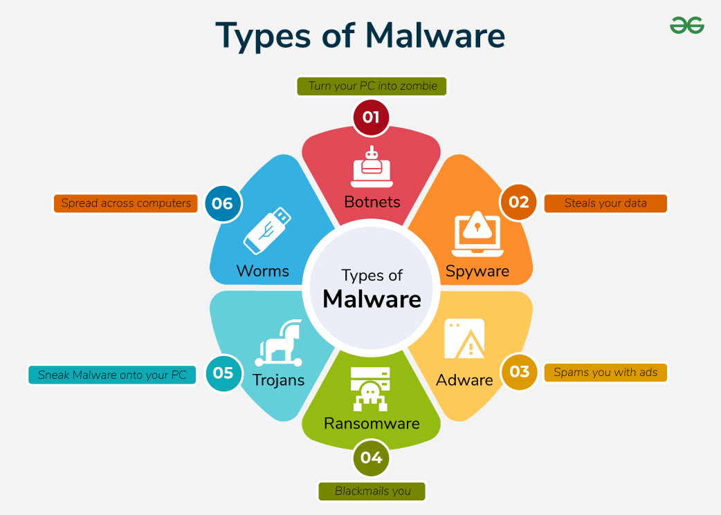
Malware
Representative malware types:
e.g., Worm, Trojan, and Ransomware.
https://www.geeksforgeeks.org/ethical-hacking/malware-and-its-types/

Slide 10
Malware
Worm: replicates itself and spreads across networks and systems without user interaction (the way it spreads relies on exploiting vulnerabilities in network protocols or systems)
Trojan: appears as a benign program (actually containing malicious code) and relies on social engineering to deceive users into installing them.

Slide 11
Malware
Worm: replicates itself and spreads across networks and systems without user interaction (the way it spreads relies on exploiting vulnerabilities in network protocols or systems)
Trojan: appears as a benign program (actually containing malicious code) and relies on social engineering to deceive users into installing them.
Ransomware: generates an encryption key on its own, uses the key to encrypt a victim’s files and demands payments for decryption.
Note a symmetric key is preferred but why?

Slide 12
Malware evasion:
encrypts/modifies its code to evade the detection by anti-malware
Common evasion techniques:
oligomorphic
polymorphic
metamorphic
https://www.geeksforgeeks.org/ethical-hacking/evolution-of-malwares-from-encryption-to-metamorphism/

Slide 13
Malware
Malware
body
pattern

Slide 14
Malware
Malware
Anti-malware pattern detection
body
pattern

Slide 15
Malware
Anti-malware pattern detection
Malware
pattern
encrypted body

Slide 16
Malware
single decryptor
pattern
Malware
pattern
Anti-malware pattern detection
encrypted body

Slide 17
Oligomorphic Malware
n decryptors
e.g., 10^2
pattern

Slide 18
Oligomorphic Malware
n decryptors
e.g., 10^2
pattern
Malware replicates itself and infects others

Slide 19
Oligomorphic Malware
n decryptors
e.g., 10^2
pattern
Malware
encrypted body
decrypted body
encrypted body
Malware replicates itself and infects others

Slide 20
Oligomorphic Malware
n decryptors
e.g., 10^2
pattern
Malware
encrypted body
decrypted body
encrypted body
Malware replicates itself and infects others
Same?

Slide 21
Oligomorphic Malware
n decryptors
e.g., 10^2
pattern
Malware
encrypted body
decrypted body
encrypted body
Malware replicates itself and infects others
Different
(most cases)

Slide 22
Oligomorphic Malware
Anti-malware pattern detection
n decryptors
e.g., 10^2
pattern
Malware
encrypted body
decrypted body
encrypted body
Malware replicates itself and infects others

Slide 23
Polymorphic Malware
n mutated decryptors
e.g., 10^9

Slide 24
Polymorphic Malware
Anti-malware pattern detection
n mutated decryptors
e.g., 10^9

Slide 25
Polymorphic Malware
n mutated decryptors
e.g., 10^9
Malware
original body
encrypted body
decrypted body
encrypted body
Malware replicates itself and infects others

Slide 26
Polymorphic Malware
n mutated decryptors
e.g., 10^9
Malware
original body
encrypted body
decrypted body
encrypted body
Malware replicates itself and infects others
Same?

Slide 27
Polymorphic Malware
n mutated decryptors
e.g., 10^9
Malware
original body
encrypted body
decrypted body
encrypted body
Malware replicates itself and infects others
Same

Slide 28
Polymorphic Malware
Malware
pattern
pattern
original body
decrypted body
Same
What can we do to detect polymorphic malware?

Slide 29
Polymorphic Malware
What can we do to detect polymorphic malware?
dynamic decryption: provide a sandbox environment to execute malware and identify the pattern of malicious code at runtime
decryption occurs
at runtime
Malware
pattern
pattern
original body
decrypted body
sandbox
Anti-malware dynamic decryption

Slide 30
Oligomorphic and Polymorphic Malware
What can we do to detect oligomorphic or polymorphic malware?
pattern detection: identify patterns/signatures in the decryptors.
dynamic decryption: provide a sandbox environment to execute malware and identify the pattern of malicious code at run-time

Slide 31
Metamorphic Malware
Different
Malware
Malware
Malware
Malware
original body
muted body
muted body
muted body
Malware replicates itself and infects others

Slide 32
Metamorphic Malware
Garbage (or flower) instruction: insertion of unnecessary instructions within a malware to obfuscate software analysis but retain the main logic of the malware.
mov eax, ebx; move the value of ebx into eax
nop; no operation

Slide 33
Metamorphic Malware
pattern detection
Different
?
?
Malware
Malware
Malware
Malware
original body
muted body
muted body
muted body
Malware replicates itself and infects others

Slide 34
Metamorphic Malware
pattern detection
Different
Malware
Malware
Malware
Malware
original body
muted body
muted body
muted body
Malware replicates itself and infects others

Slide 35
Metamorphic Malware
What can we do to detect metamorphic malware?
heuristic detection: provide a sandbox environment to execute malware and identify suspicious behaviours at run-time.

Slide 36
Malware
Summarize the main characteristics of oligomorphic, polymorphic and metamorphic malware

Slide 37
Malware
Summarize the main characteristics of oligomorphic, polymorphic and metamorphic malware
oligomorphic: it decrypts itself with a limited number of decrpytors each time it infects others.
polymorphic: it decrypts itself with an unlimited number of decrpytors each time it infects others.
metamorphic: it mutates itself significantly each time it infects others.

Slide 38
Malware
What are the benefits of studying evasive malware?
e.g., the attacker’s perspective/the defender’s perspective

Slide 39
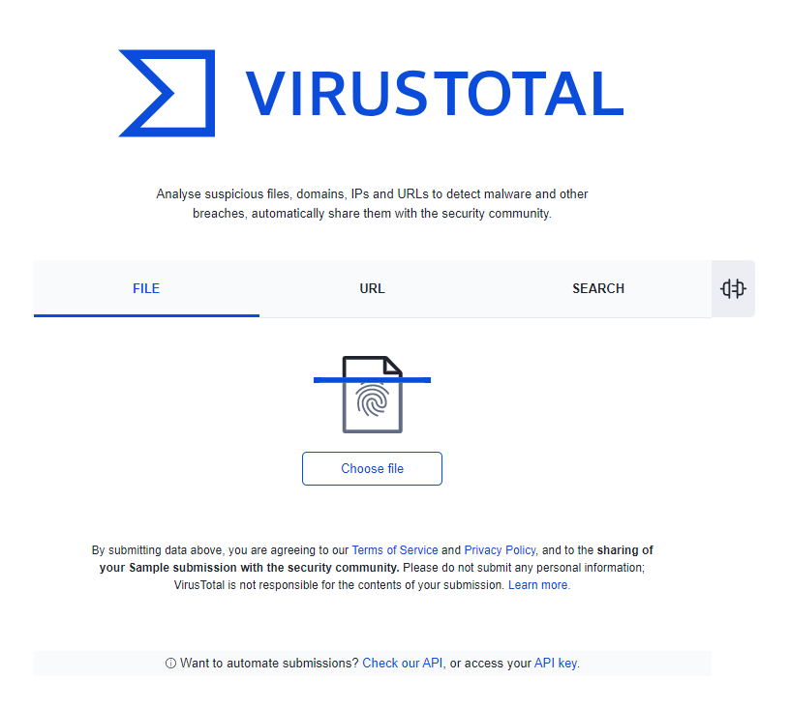
Malware Detection
Virus Total is a website (https://www.virustotal.com/gui/home/upload) that provides free online malware scanning.
It uses over 70 antivirus scanners and URL/domain blocklisting services.
Provides a comprehensive view of whether a file or website is malicious.

Slide 40
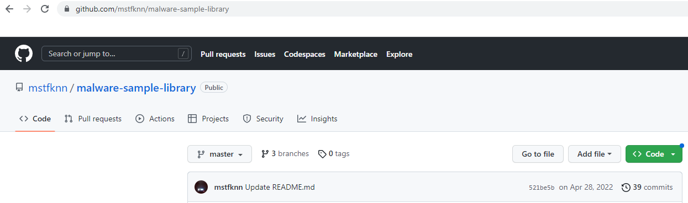
Malware Detection
Demo: use our VMs to download malware samples
https://github.com/mstfknn/malware-sample-library

Slide 41
Malware Detection
How to run the demo
Upload each malware file (can be compressed) onto virustotal

Slide 42
Malware Detection
demo
1.0.248.27; 94.20.141.173 (Malicious IP address)
https://github.com/sefinek/Malicious-IP-Addresses

Slide 43
Malware Detection
How does VirusTotal detect malware?
Can VirusTotal detect all malware? Why or Why not?

Slide 44
Malware Detection
How does VirusTotal detect malware?
e.g., it submits a given file or URL to many anti-malware engines, which apply different techniques for scanning. The techniques can be pattern detection, dynamic decryption, heuristic detection, etc.

Slide 45
Malware Detection
How does VirusTotal detect malware?
e.g., it submits a given file or URL to many anti-malware engines, which apply different techniques for scanning. The techniques can be pattern detection, dynamic decryption, heuristic detection, etc.
Can VirusTotal detect all malware?

Slide 46
Malware Detection
How does VirusTotal detect malware?
e.g., it submits a given file or URL to many anti-malware engines, which apply different techniques for scanning. The techniques can be pattern detection, dynamic decryption, heuristic detection, etc.
Can VirusTotal detect all malware?
e.g., mutated/sandbox-aware malware.

Slide 47
Malware Detection
Yara is a rule-based signature matching tool.
It is an open-source project.
It uses a set of rules to generate a pattern/signature.
The signature describes characteristics of malware, e.g., file size, file hash, certain strings of code, etc.
https://www.cyberstash.com/an-introduction-to-yara/

Slide 48
Malware Detection
How to run the demo
sudo docker run -it --rm uwacyber/cits1003-labs:ai-malware
Inside the container
apt-get install yara
git clone https://github.com/Yara-Rules/rules.git

Slide 49

Malware Detection
How to run the demo
sudo docker run -it --rm uwacyber/cits1003-labs:ai-malware
apt-get install yara
git clone https://github.com/mstfknn/malware-sample-library.git

Slide 50
Malware Detection
How to run the demo

Slide 51
Malware Detection
How to run the demo

Slide 52

Malware Detection
How to run the demo

Slide 53
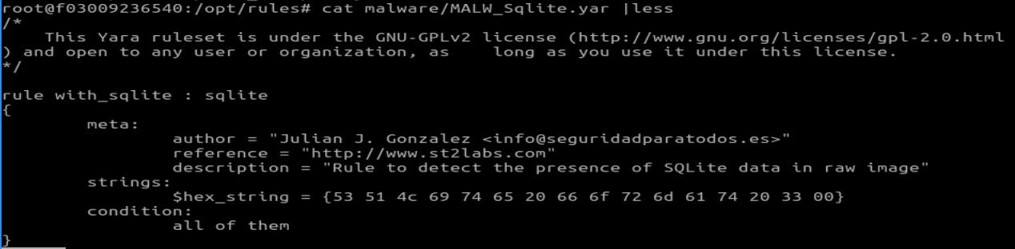
Malware Detection
How to run the demo

Slide 54
Malware Detection
demo

Slide 55
Malware Detection
List a few practical use-cases of YARA in cybersecurity

Slide 56
Malware Detection
List a few practical use-cases of YARA in cybersecurity
e.g., malware detection/intrusion detection/system monitoring
Match known attack payloads or exploit code in captured packets.
Identify phishing attachments by signature or suspicious macro content.
YARA can be scheduled or triggered to continuously scan systems for suspicious changes.

Slide 57
Malware Detection
Ember is an AI-based signature detection tool.
It is an open-source project.
It uses a deep-learning-based model to predict whether a given file is malicious.
The file type is limited to windows-specific PE (portable executable).

Slide 58
Malware Detection
How to run the demo
sudo docker run -it --rm uwacyber/cits1003-labs:ai-malware
Unzip malware.zip (password:: infected)
python3 scripts/classify_binaries.py -m ember_model_2018.txt malware
python3 scripts/classify_binaries.py -m ember_model_2018.txt git.exe

Slide 59
Malware Detection
demo

Slide 60
Malware Detection
What is the main difference between Yara and Ember?
What can be done to improve them?

Slide 61
Malware Detection
What is the main difference between Yara and Ember?
e.g., Yara is rule-based while Ember is DL-based.
Yara supports multiple file types while Ember is limited to one type.

Slide 62
Malware Detection
What is the main difference between Yara and Ember?
e.g., Yara is rule-based while Ember is DL-based.
Yara supports multiple file types while Ember is limited to one type.
What can be done to improve them?

Slide 63
Malware Detection
What is the main difference between Yara and Ember?
e.g., Yara is rule-based while Ember is DL-based.
Yara supports multiple file types while Ember is limited to one type.
What can be done to improve them?
e.g., Yara’s limitation: rule-based signature matching, which makes it hard to work against advanced mutation techniques.
Ember’s limitation: its dataset used for DNN model training is outdated and it supports Windows PE only.

